Slide 1
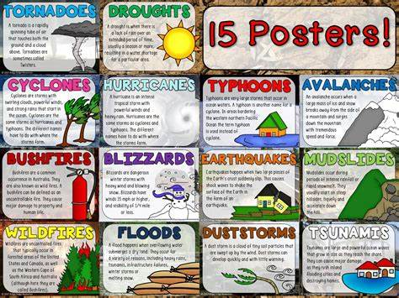
Natural disasters

Slide 2
What is a natural disaster
A natural disaster is a major adverse event resulting from natural processes of the Earth; examples are floods, hurricanes, tornadoes, volcanic eruptions, earthquakes, tsunamis, and other geologic processes.
Some disasters are caused by humans: for example: bomb explosion.

Slide 3
Earthquakes
Earthquakes are caused by tectonic plates. Earthquake can be small to very big and huge. Earthquake can do damage to buildings and homes.

Slide 4
Helpful links
https://www.basicplanet.com/natural-disasters/
https://www.basicplanet.com/volcano/

Slide 5
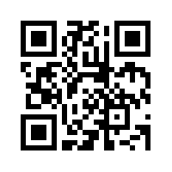
Qr code to basic planet

Slide 6
tsunami
A Tsunami is a series of gigantic water waves that causes a surge of water onto land. These surges can reach heights up to 100 feet. The massive height of the surges can lead to devastating effects when it crashes over land. It can occur in large lakes but mainly occurs in seas.
Tsunamis formed by earthquakes and volcanoes.

Slide 7
volcano
Volcanoes have been pictured violently assaulting the earth and life around them since the earliest of times. There are cultures that have many myths wrapped deeply in the heart of volcanic action and still others that keep a current day watch on active volcanoes they live near.

Slide 8
How does volcanoes formed
The earth’s crust is composed of enormous sections of rock called tectonic plates. Tectonic plates resemble puzzle pieces and are constantly moving toward, against, and alongside one another. Volcanoes often form in the areas where tectonic plates make contact. The friction created by the movement between two plates can melt solid rock in the mantle and turn it into magma. This hot, molten rock creates great pressure, and over time, it finds its way up to the surface of the crust through fractures. Once magma reaches the surface of the earth, it is called lava.
Approximately 1500 volcanoes around the world are considered "active." Of these, nearly 90% lie in the "Ring of Fire," which is a perimeter of oceanic volcanoes that circle the Pacific Ocean. These active volcanoes were formed by the subduction of oceanic plates under continental plates.

Slide 9
questions

Slide 10
Write the answer on the questions slides. Do not write on the information slides.

Slide 11
What is a volcano?

Slide 12
Where does the qr code takes you to on slide 5?

Slide 13
How earthquakes formed?

Slide 14
How does a tsunami formed?

Slide 15
How does volcanoes formed?

Slide 16
Basic planet link
https://www.basicplanet.com/

